Slide 1
ACT Prediction
Supreet Sandhu

Slide 2
The Problem:
How can we predict an ACT score from socioeconomic factors?

Slide 3
Data Source
Education gap Data: National Center for Education Statistic.
State Political Party: New York Times

Slide 4
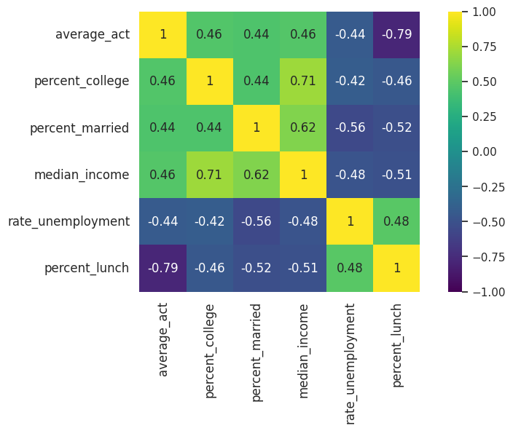
Selecting our Data
-Correlation of the average act to the predictor variables

Slide 5
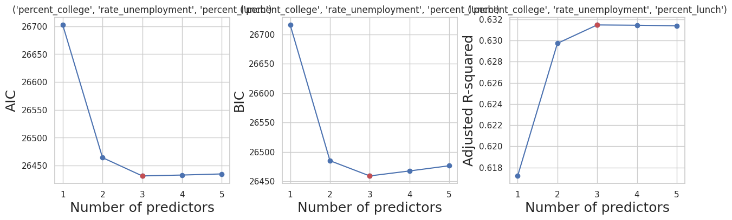
The best model has three predictors.

Slide 6
Factors: Lunch, College, Unemployment
Based off the adjusted R squared graph: lunch + college + unemployment predictors have the highest R squared value
R Square value: 0.64

Slide 7
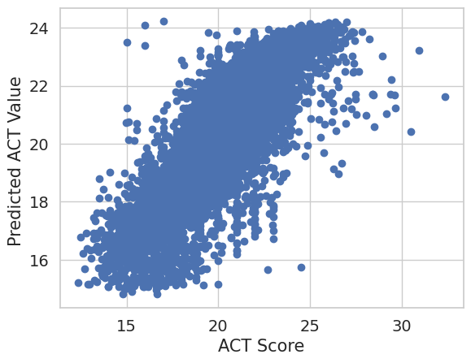
Our Model vs. Actual ACT Score

Slide 8
Additional Step: State’s Political Part

Slide 9
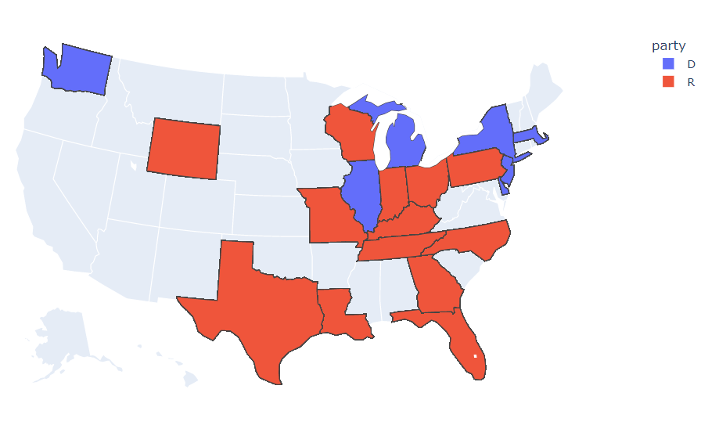
Limitations
Limited data: There was only data from 20 states.
Vast majority of the states were Republican

Slide 10
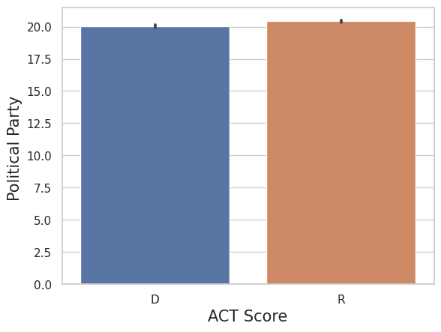
Comparing the Political Parties to Average ACT
Average Act Sore
Conclusion hard to draw
Political party

Slide 11
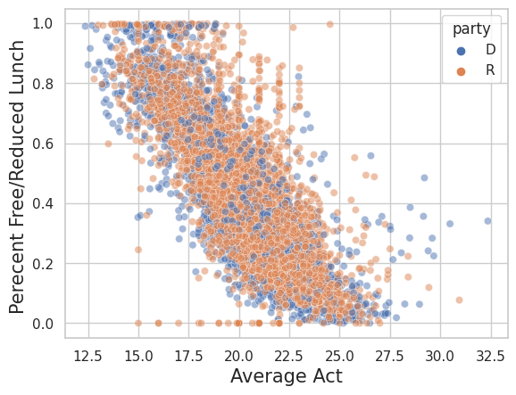
Free/Reduced Lunch to Average ACT

Slide 12
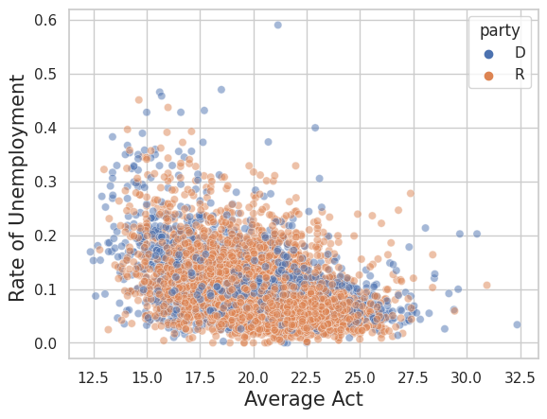
Rate of Unemployment to Average ACT

Slide 13
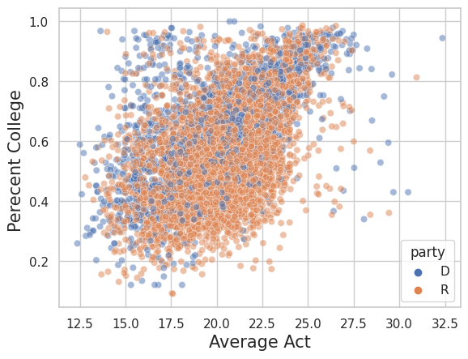
Percent College to Average ACT

Slide 14
Conclusion
A Model that predicts average act:
Percent Reduced Lunch
Percent Going to College
Rate of unemployment
Success of Model: Somewhat Decent, not totally accurate
No Correlation found between political party and average act, predictor factors

Slide 15
Questions?

